Slide 1
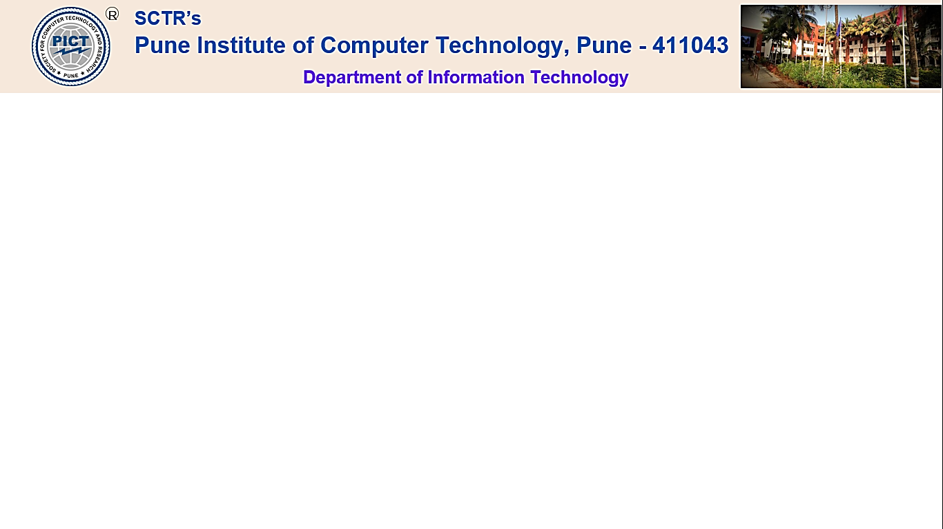
Project Phase-II
Youth YANA ( You Are Not Alone ): Mental Health Consulting WebApp
Group Id: 41
Group Members:
Sumit Kawale B190058594
Harshvardhan Patil B190058653
Onkar Swami B190058721
Tanmay Bonde B190058723
Name of Guide: Mrs. Kirti Digholkar
Name of Reviewers: Mr. Sachin Pande
Mrs. Prajakta Shinde
Domain: AI-ML + MERB

Slide 2
INTRODUCTION
PROBLEM STATEMENT
ABSTRACT
LITERATURE SURVEY
TRADITIONAL SYSTEM
SURVEY ON APPS
USER AND SYSTEM REQUIREMENTS
UML DIAGRAMS
ALGORITHMS AND MODELS
IMPLEMENTATION IMAGES
REFERENCES

Slide 3
Introduction
College student’s Mental Health is crucial for self-discovery, education, and personal growth, requiring empathy and understanding. There are various reasons due to which we are Developing this, reasons are as follows:
Student usually try to avoid visiting counsellor.
Lately scheduled Appointments.
Lack of Privacy

Slide 4
Problem Statement
The primary problem we aim to address is the limited accessibility and confidentiality issues around mental health counseling for college students.
Key aspects of the problem include:
Lack of Resources: Universities often have a shortage of mental health professionals, leading to long wait times for appointments.
Stigma: There is a stigma surrounding mental health, preventing many students from seeking help.
Confidentiality: Students may be hesitant to share their thoughts and feelings with human counselors due to concerns about privacy and judgment.
Accessibility: Some students may not have access to counseling services due to geographical constraints or other logistical barriers.

Slide 5
Abstract
Youth YANA is proposing a web-based mental health consulting system for college students, focusing on privacy, security, and technology. The system includes a self-screening and referral system, web device-based mental health analysis, and a web-app for assessing mental health applications. The system uses an ML model to detect mental health issues early and provide necessary steps to overcome them, highlighting the importance of privacy and security in the digital era.

Slide 6
Literature Survey
Year | Author | Domain and Problem Statement | Conclusion and result
2021 | V.D.Kulkarni, Tanuja Gondkar, Gunjan Singh, Aditi Gulunjkar | Addressing Mental Health Epidemic among University Students via Web-based, Self-Screening, and Referral System | This system is suitable for university students, staff, and workers experiencing mental health issues due to studies, addiction, or bad habits. It is also applicable in hospitals and industries for confirming normality.
2021 | Eung-Hun Kim, Anil Coumar, William B. Lober, and Yongmin Kim | Engineering students and professionals living with mental illness | A web-based mental health screening and referral system for university students was developed and evaluated, showing increased patient volume, high off-hour use, and positive student responses. Converted to routine clinical use.

Slide 7
Literature Survey
Year | Author | Domain and Problem Statement | Conclusion and result
2020 | ROHIZAH ABD RAHMAN 1 , KHAIRUDDIN OMAR 1 , SHAHRUL AZMAN MOHD NOAH1 , (Member, IEEE), MOHD SHAHRUL NIZAM MOHD DANURI 2 , (Member, IEEE), AND MOHAMMED ALI AL-GARADI | Application of Machine Learning Methods in Mental Health Detection: A Systematic Review | This systematic review evaluates mental health problem detection using OSNs, focusing on data source, feature extraction, and ML techniques. It suggests OSNs can complement traditional methods but requires further adoption and innovative algorithms.
2021 | Ms. Sumathi M.R. , Dr. B. Poorna | Prediction of Mental Health Problems Among Children Using Machine Learning Techniques | Expert systems in medical and mental health fields predict diseases and mental health problems early. A study comparing eight ML techniques found MLP , Multiclass Classifier, and LAD Tree produce more accurate results.

Slide 8
Traditional Ways
Sr. No. | Available System | Technique | Features
1) | Narrative System and Qualitative method | Inquiry,Semi-structured Interviews. | Narrative Inquiry.
2) | Questionnaires and Answers | Self-developed Questionnaires and DASS-21 inventory | Simple Question Answer.
3) | Web-based Self-Screening and Referral system | Machine Learning and Encryption and Security | PHI , Faster schedule Appointment .
4) | ELM (Extreme Learning Model) | ML and MLP | Balancing the degree of privacy protection and classification accuracy
5) | Digital Psychiatry | AI and ML (SVM) | Being used in education, work,social media etc. too.
6) | Bayes Model | BOW,CNN,NN etc | It has Better Accuracy.

Slide 9
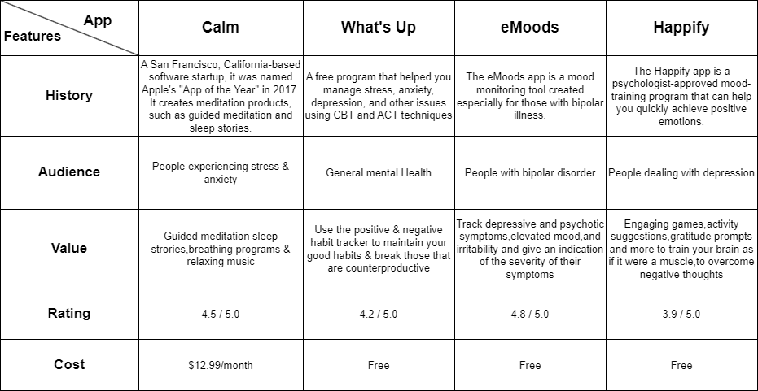
Survey of Apps

Slide 10
User Requirements
Abstract
User-Friendly Interface and Chat Support
User Registration and Profile Management
In-App Counseling
Medication and Pharmacy Integration
Emergency Support and Personal Counselor
User Feedback and Ratings

Slide 11
System Requirements
Operating system: The webapp should be compatible with the major operating systems, such as Windows, macOS, and Linux.
Web browser: The web-app should be compatible with the major web browsers, such as Chrome, Firefox, and Safari.
Internet connection: The webapp requires a reliable internet connection to access its features and functionality.
Hardware: The webapp should be able to run on a variety of hardware devices, including desktop computers, laptops, tablets, and smartphones. However, the specific hardware requirements will vary depending on the features and functionality of the app.

Slide 12
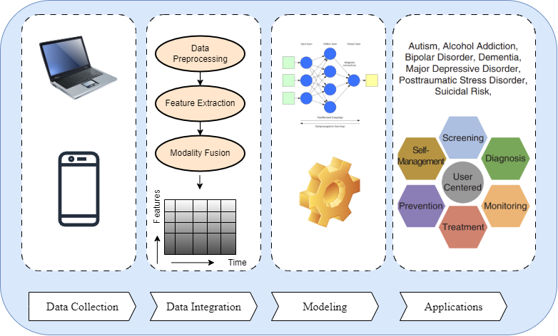
Functional Block Diagram

Slide 13
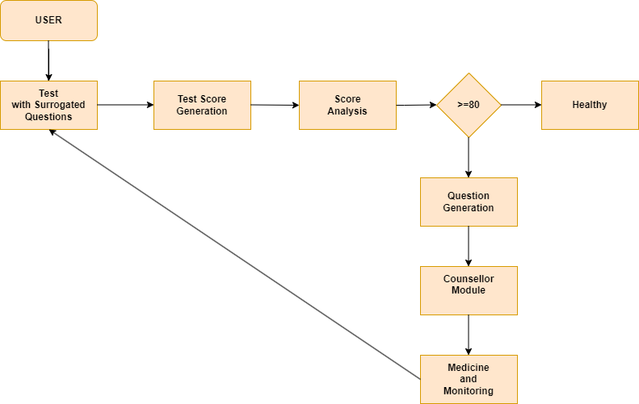
Architecture Diagram

Slide 14
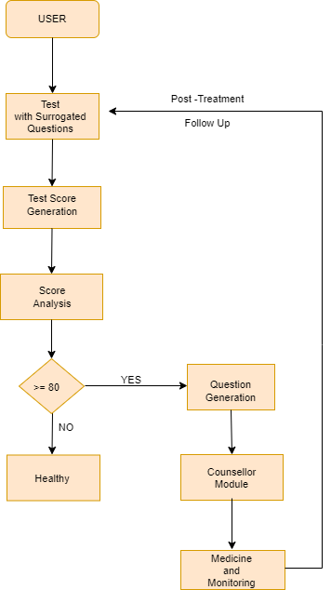
Flow Diagram

Slide 15
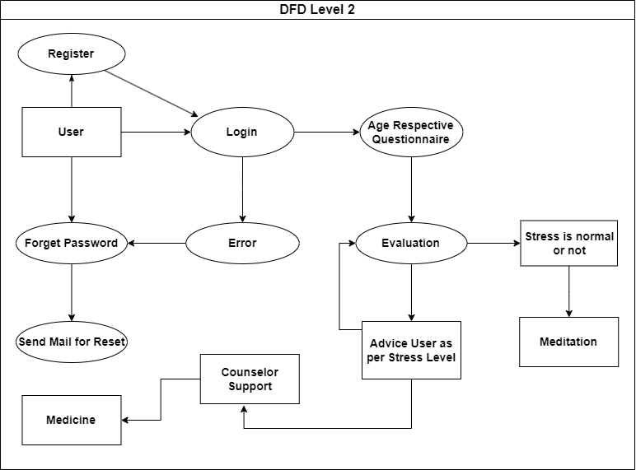
DFD Diagram

Slide 16
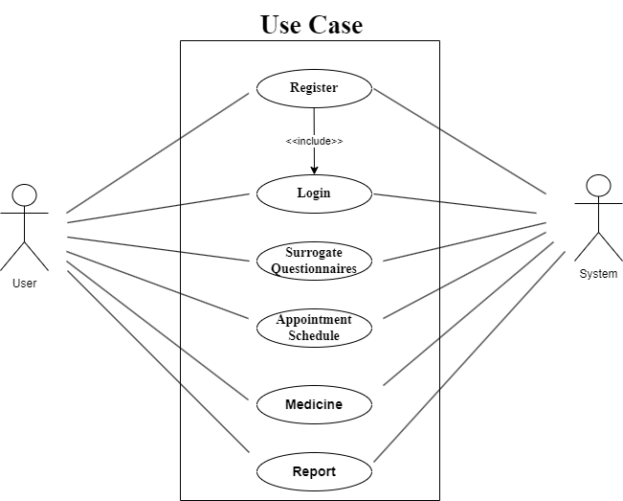
Use-Case Diagram

Slide 17
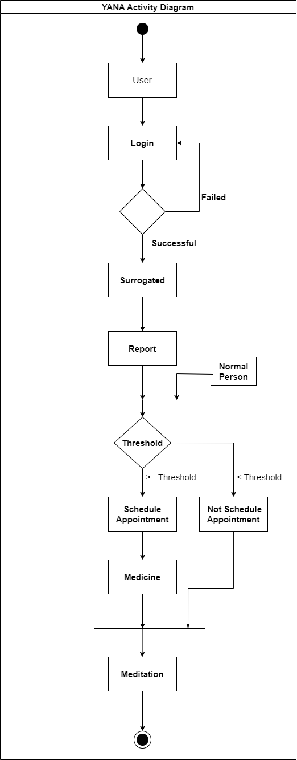
ActivityDiagram

Slide 18
Algorithms And Models
Algorithms available:
Multilayer Perceptron (MLP)
CNN
LAD Tree
SVM
RBF Network
KStar(K*)
AODEsr
DT
We Have Established algorithm t-5 (HuggingFace) for its versatility, and then We’ve results of initial testing and validation.

Slide 19




Technology Stack

Slide 20

Implementation Images

Slide 21
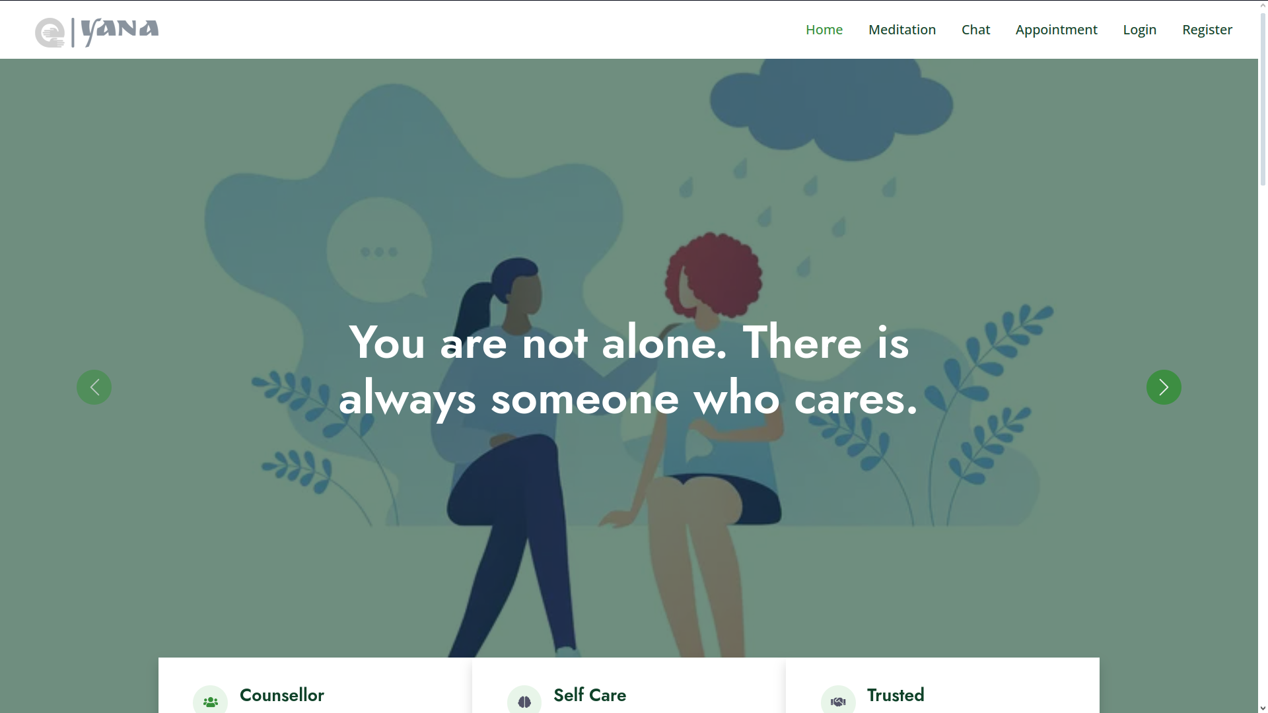
Implementation Images

Slide 22
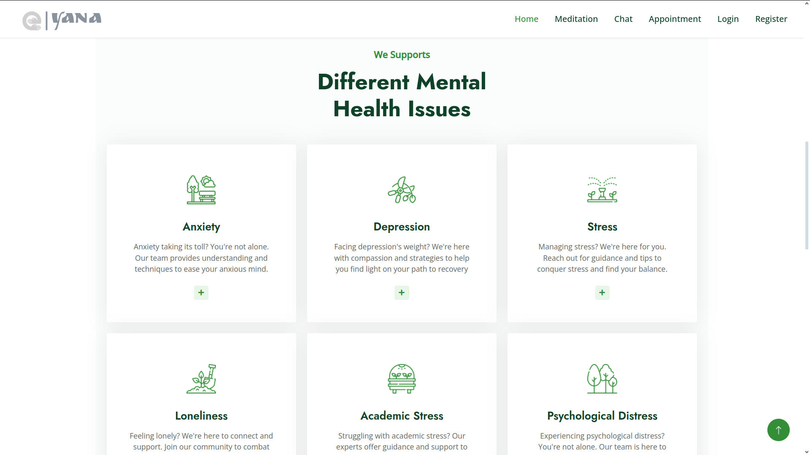
Implementation Images

Slide 23
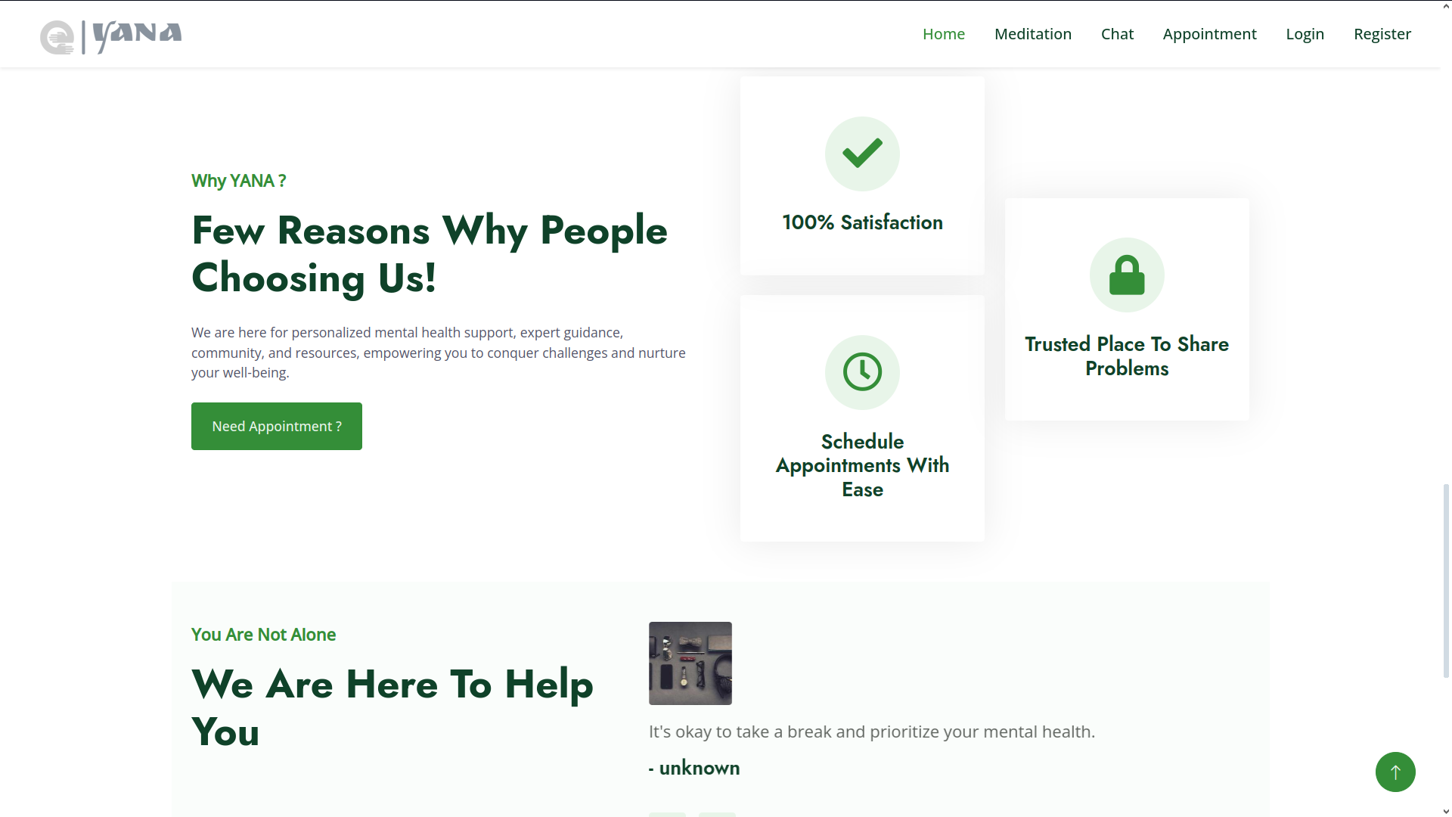
Implementation Images

Slide 24
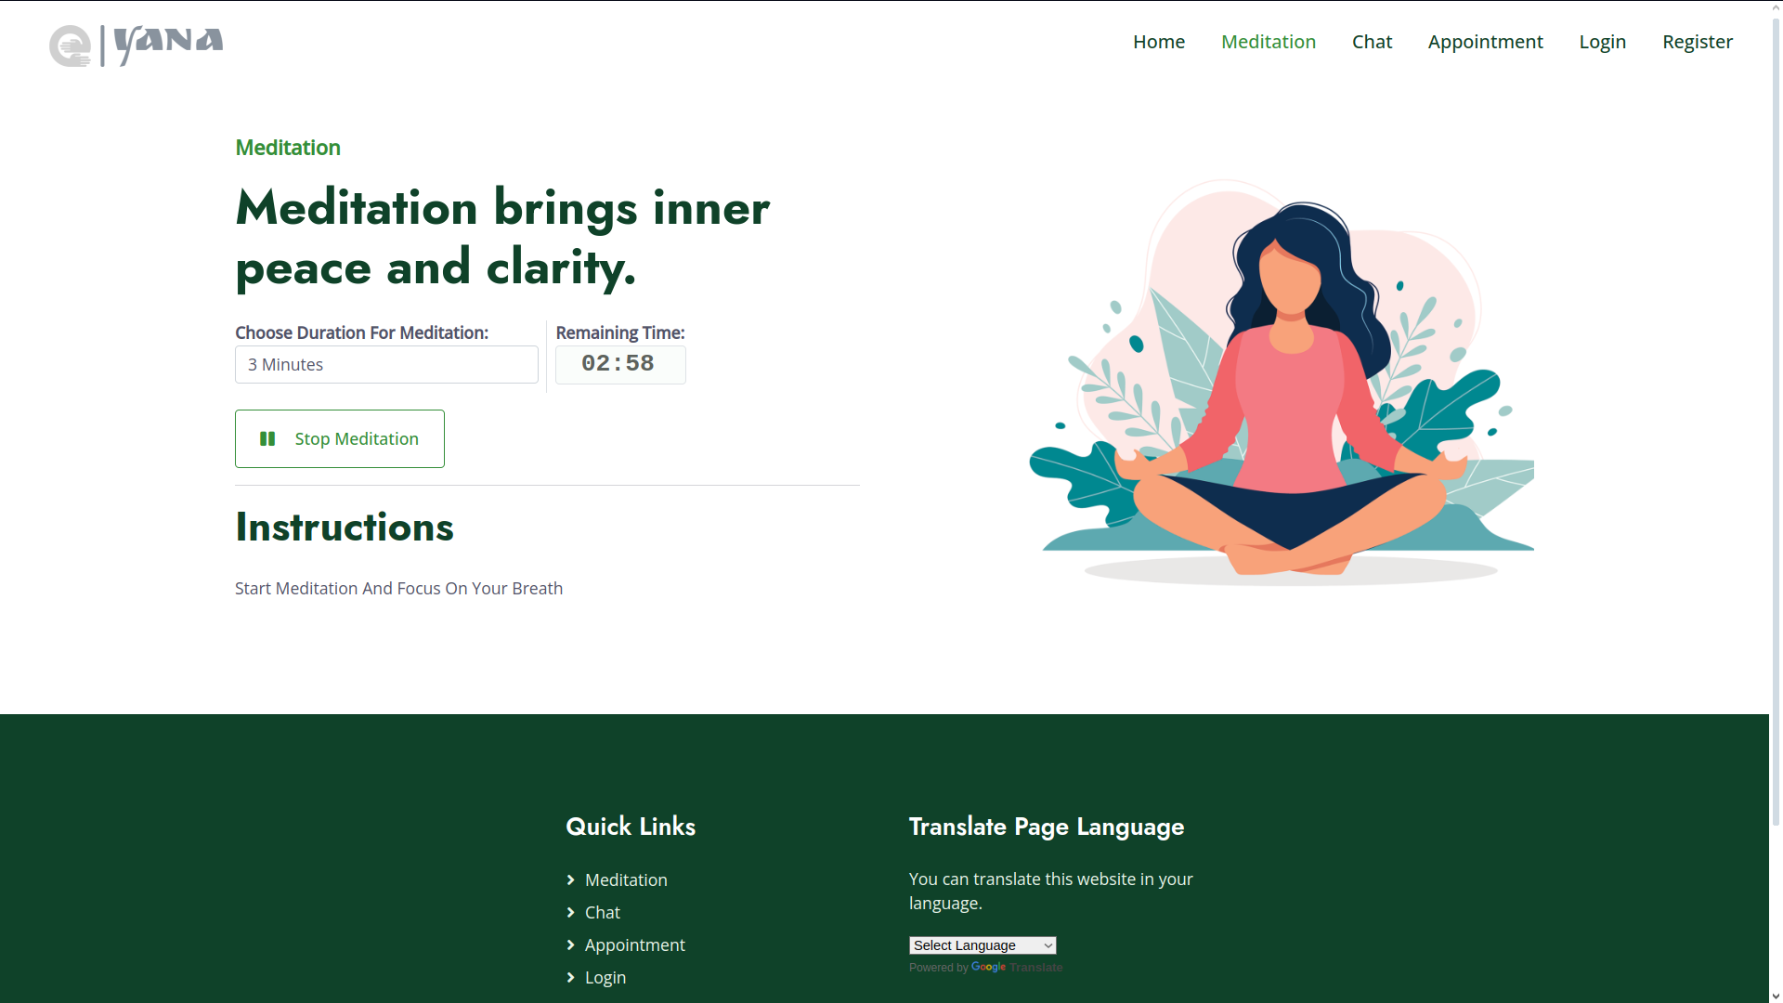
Implementation Images

Slide 25
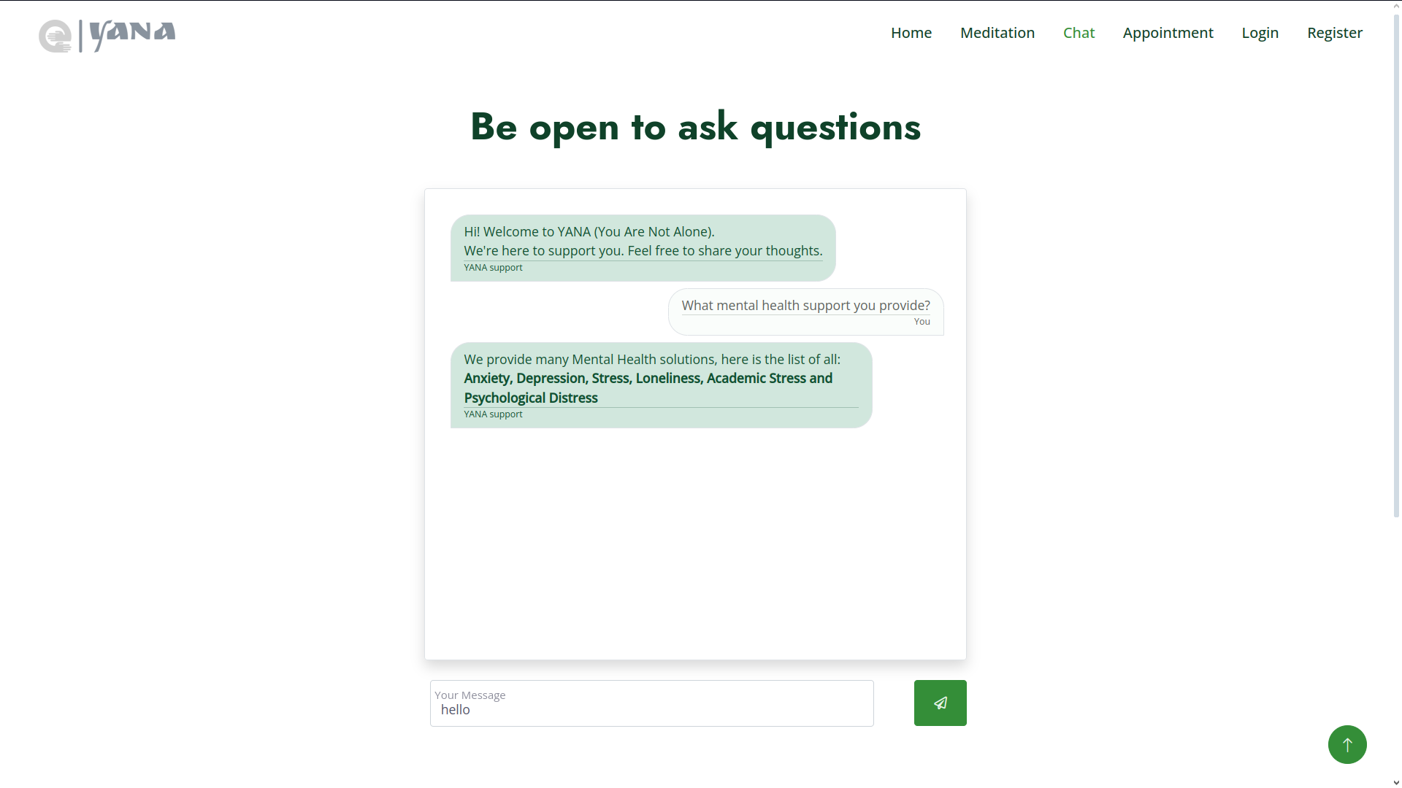
Implementation Images

Slide 26

Implementation Images

Slide 27
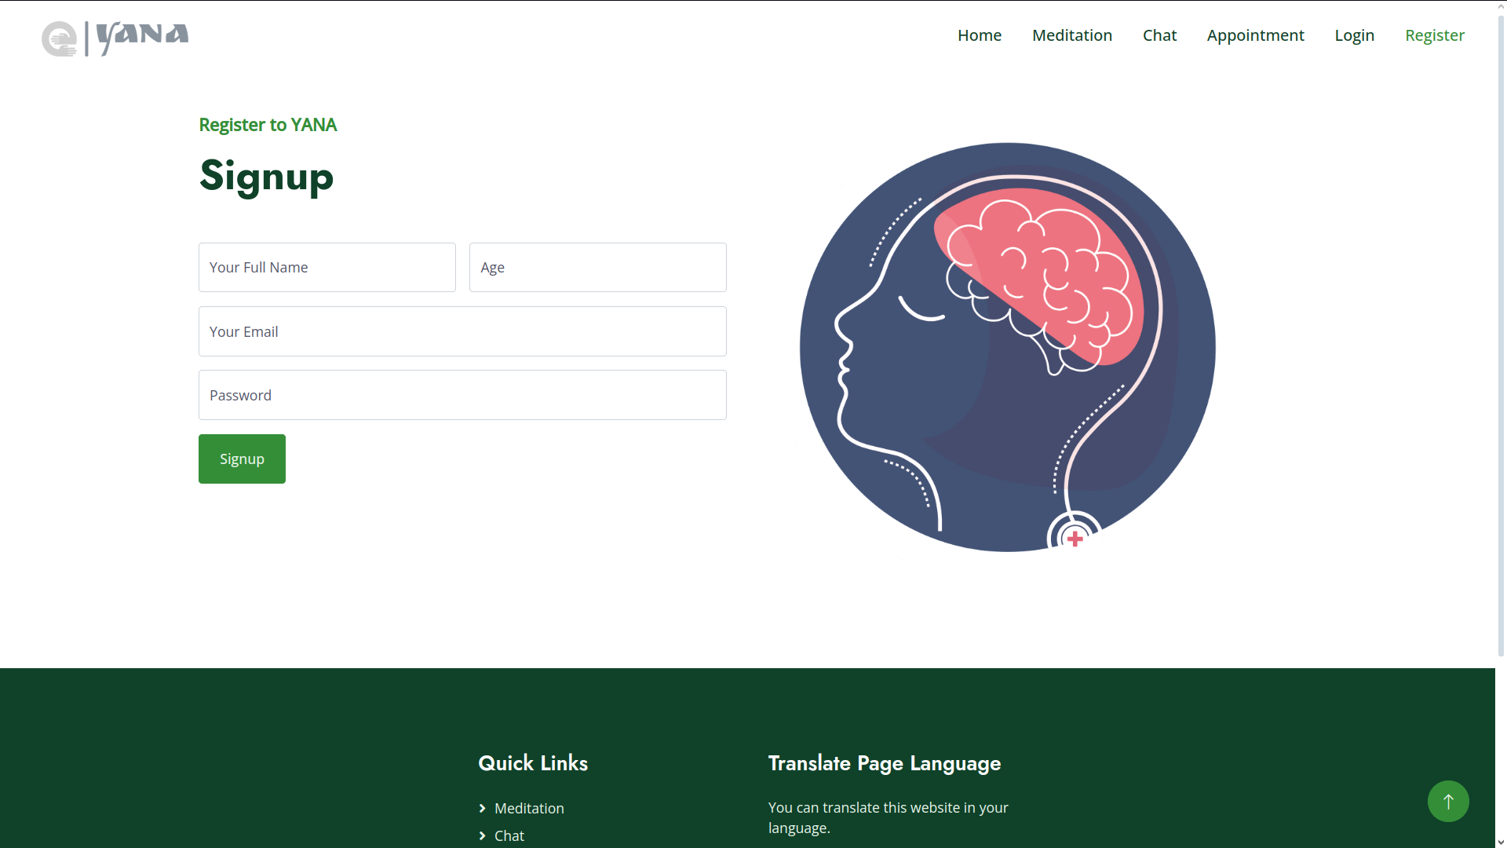
Implementation Images

Slide 28
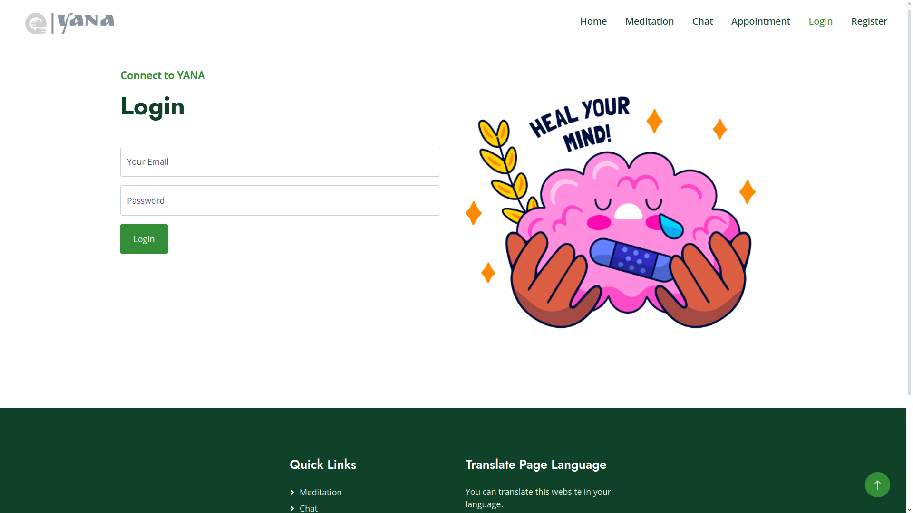
Implementation Images

Slide 29
References
[1] Rohizah Abd Rahman, Khairuddin Omar, Shahrul Azman Mohd Noah, Mohd Shahrul Nizam Mohd Danuri, and Mohammed Ali Al-Garadi. Application of machine learning methods in mental health detection: a systematic review. Ieee Access, 8:183952–183964, 2020.
[2] Dennis Becker. E-mental health: Contributions, challenges, and research opportunities from a computer science perspective. In Encyclopedia of E-Health and Telemedicine, pages 928–936. IGI Global, 2016.
[3] Christopher Burr, Jessica Morley, Mariarosaria Taddeo, and Luciano Floridi. Digital psychiatry: Risks and opportunities for public health and wellbeing. IEEE Transactions on Technology and Society, 1(1):21– 33, 2020.
[4] Yan Ding, Xuemei Chen, Qiming Fu, and Shan Zhong. A depression recognition method for college students using deep integrated support vector algorithm. IEEE access, 8:75616–75629, 2020.
[5] Jing Han, Zixing Zhang, Cecilia Mascolo, Elisabeth Andre, Jianhua Tao, Ziping Zhao, and Bjorn W Schuller. Deep learning for mobile ̈ mental health: Challenges and recent advances. IEEE Signal Processing Magazine, 38(6):96–105, 2021

Slide 30
Thank You!!!!!!
Any questions or suggestions?

